Slide 1
BRAND POSITIONING
TOMBOY STYLE BRANDS
Laura Burr, Emma Gustafsson,
Kayla Head & Emily Phillips

Slide 2
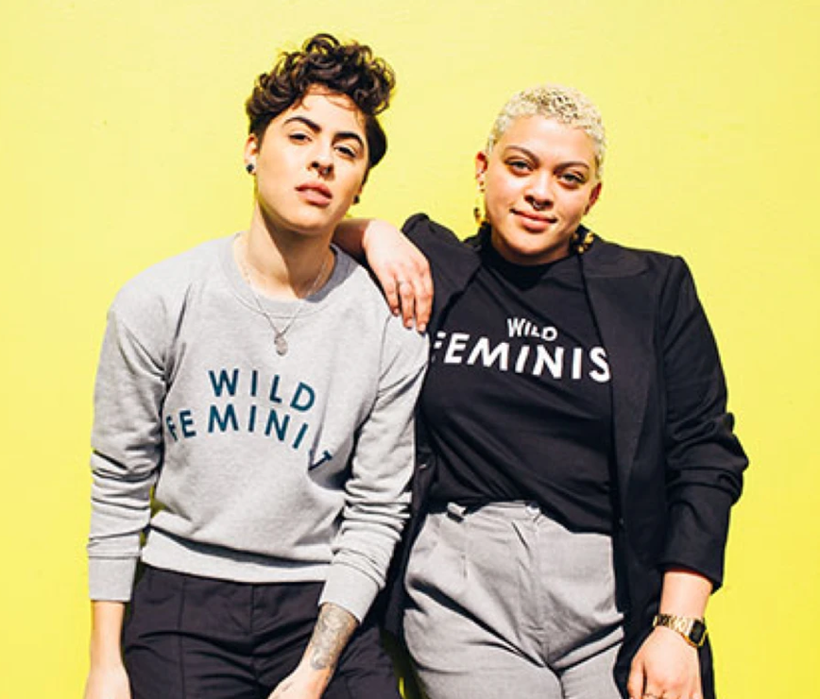
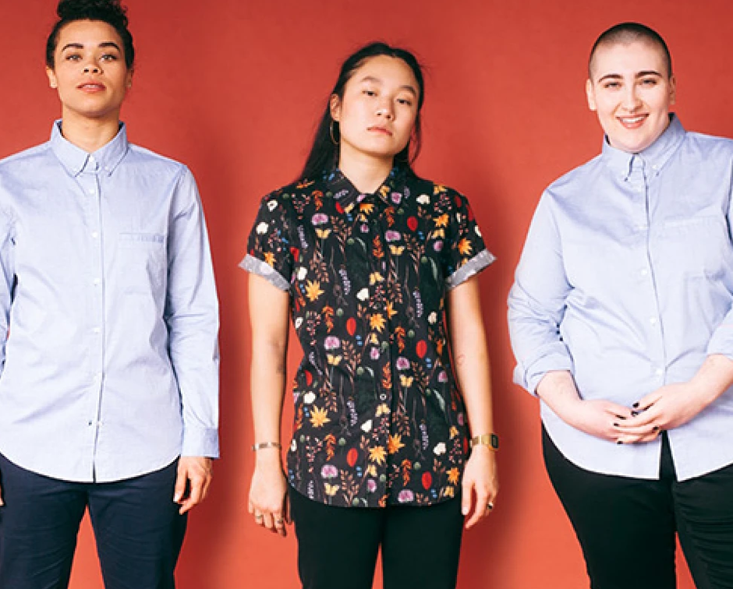
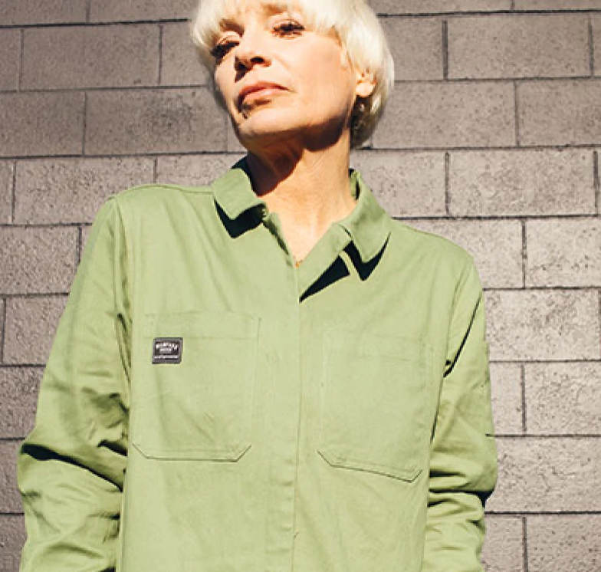
WILDFANG
Brick-and mortar and e-commerce
Independently owned
$5-$300
Their target customer is,““badass women..”... who have the right to wear..and be..whatever [and whoever] they want.”
The merchandise is androgynous with feminine touches like color, script, and some prints. Many of the pieces appeal to multiple gender identities with the core being comfortable, wearable clothing and accessories.
Wildfang is known for caring for women and happiness. Preaching women’s rights while also catering to women who seek traditionally male clothing pieces that fit women’s bodies are two of the company’s values.

Slide 3
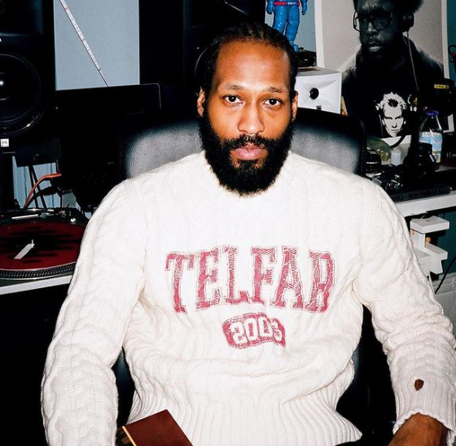
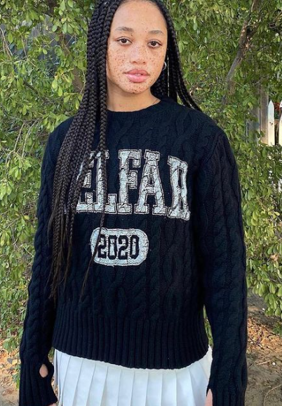
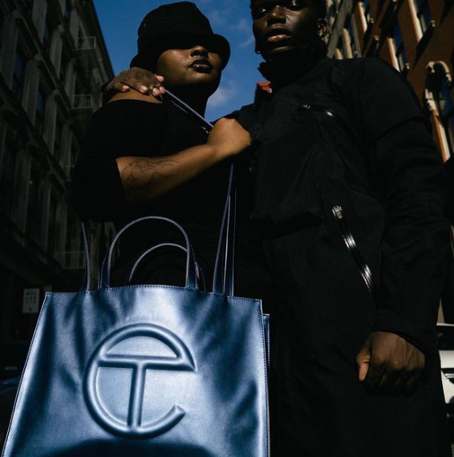
Telfar
Genderless fashion label by Telfar Clemons
Independently owned
Telfar is a luxury brand with clothing priced from the high 90s to 500 dollars.
The target customer is people wanting unisex designs for simple and comfortable sportswear which has since developed into designer bags.
“Not for You, For Everyone” is what the company strives for. When you look at the website and product you can tell that he wanted the street credit for his designs. He also grew up in a friend group that dressed unisex giving him his inspiration to reach both male and female customers.
Clemons is more interested in what everyone wears rather than what one “rare” person wears making this consumer a unique one to find. He started out by taking apart apparel, bleaching it, then putting it back together to find his personal style which has transfixed into the consumers he tries to reach, a consumer that is not defined by gender, but the edgy comfortable apparel he designs.

Slide 4
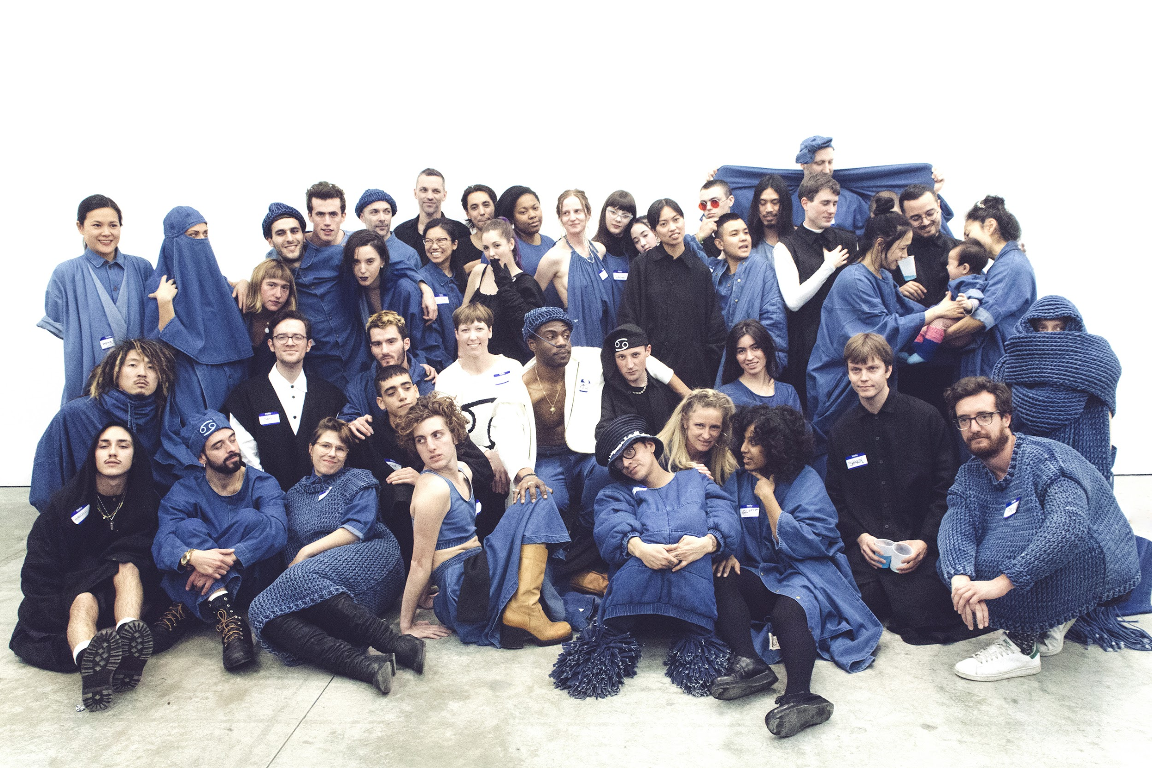
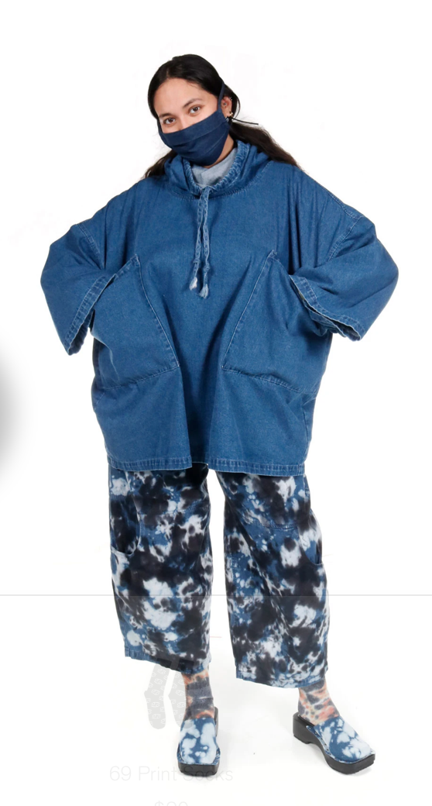
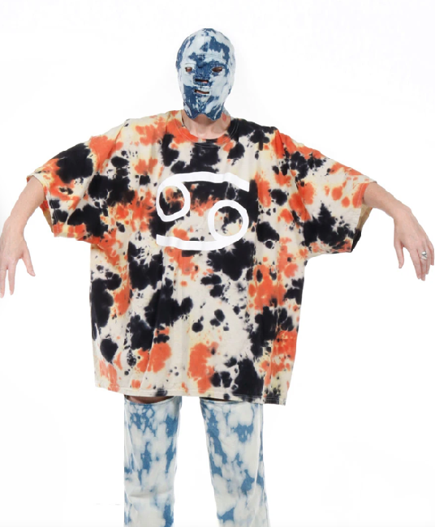
69
Web, brick-and-mortar, and sell to family owned shops
in the Los Angeles area to support local businesses
Private label brand based out of Los Angeles, California
$25-$500
The brand claims to be “non-demographic” as to include all to their pieces. However, market research has found their target audience to be
69’s brand image is fun, inclusive, joyous, sensuall, and creative
As a non-gender, “non-demographic” brand, 69 is known for making inclusive, mostly denim lifestyle pieces in the Los Angeles area frequently featuring guest designers that are up-and-coming. The anonymous founder chose the name “69” because it can be used as a verb, noun, or an adjective, perfectly all encompassing.

Slide 5
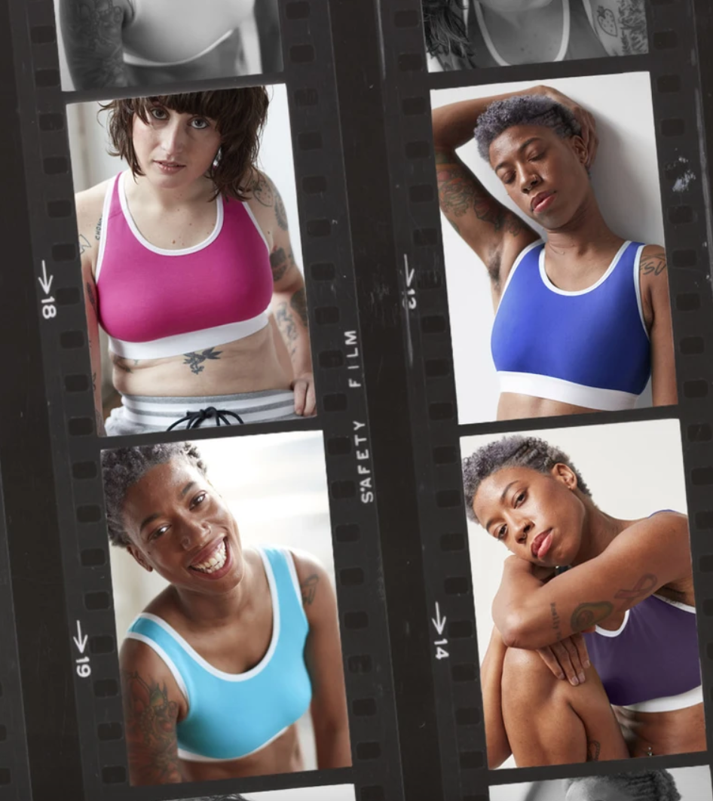
TOMBOY X
Web-based business model
Independently owned brand
Merchandise ($5-80) consists of adaptive apparel that is ethically made.
  Undergarments
  Apparel
  Swim
This company aims to target the LGBTQ+ community and those that want to “express themselves without constraint”.
Brand image:
  Diversity, individuality, inclusivity, empowerment, adaptivity, liberation
Comfort in adaptability
  “We believe that everything you put on your body should make you feel great exactly as you are, and help you express yourself without constraint. That means we are dedicated to not only making high-quality apparel but making it fit everyone who loves it”.
Notes:
https://tomboyx.com/pages/ourstory

Slide 6
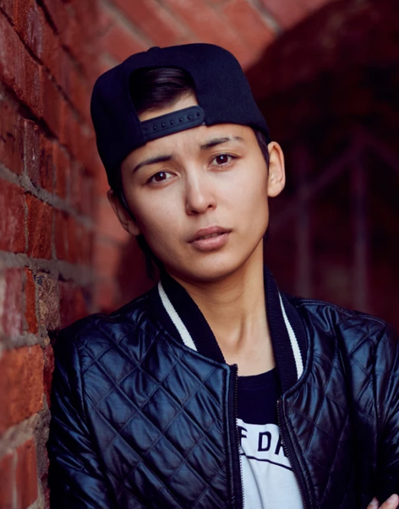
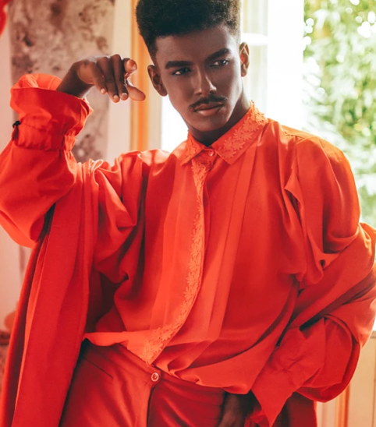
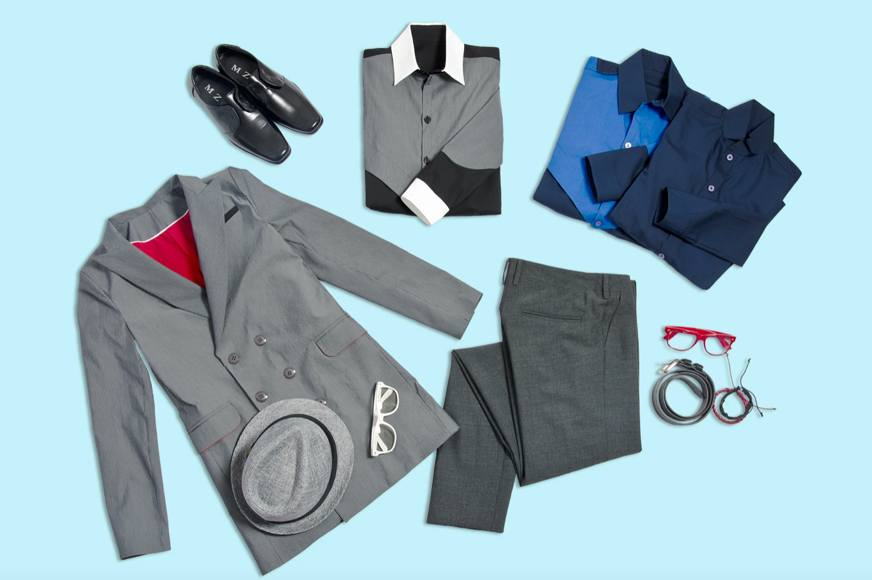
VEEA
Online retailer
Private label
For a $20 fee, you can pick 5 items from the shop to be sent to you. You can keep/return what you want, and if you want to keep all 5 you will get a 20% discount.
The inferred target customer is millennial aged people with androgeounous styles
VEEA provides androgeounous clothing that goes
beyond basic t-shirts to customers of all ages, genders, sexual preferences, etc. This brand offers all people fashionable and classic genderless clothing.
Brand Image: androgeounous, inclusive, high-end, modern, classy
VEEA creates an inclusive and prejudice-free shopping experience for all people of all beliefs and orientations.

Slide 7
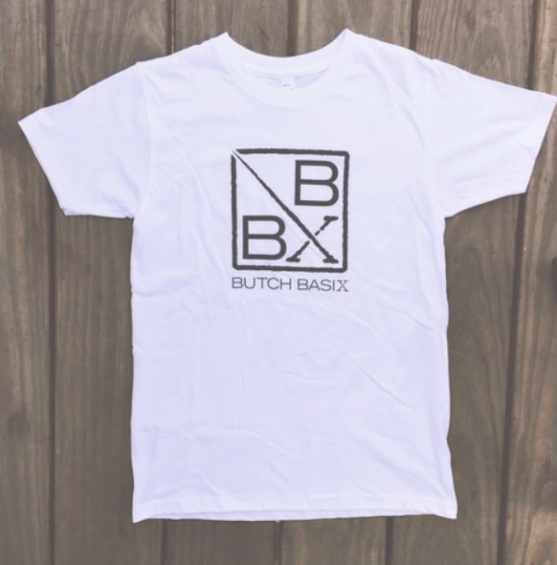
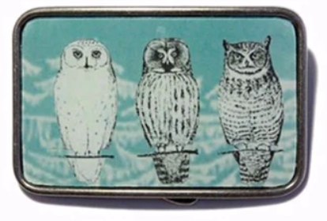

BUTCH BASIX
Online retailer
Carries various brands of clothing, personal care, and home items
Price range:
  Clothing: $25-$125
  Personal Care: $7-$35
  Home items: $24-$37
The inferred target customer is mid to older millennial aged people of any gender with traditionally masculine styles
Brand Image: masculine, rustic, inclusive
Butch Basix was created to combat frustration of shoppers when looking for masculine clothing for various body types, especially when they are only able to find t-shirts that work for them. The brand sells classically masculine style clothing to all people.

Slide 8
WILDFANG SWOT ANALYSIS
Strengths
  High reach around the world due to many locations and a strong social media presence
  Committed to diversity and their employees, increasing their human capital and resulting in efficient output
Weaknesses
  Insufficient sustainability due to poor waste management
  Price changes without explanation why
  Focus on innovative new products instead of creativity, leaving employees burnt out and stressed
Opportunities
  Maintaining a strong social presence can further increase sales and reach new markets
  Government subsidies for becoming more sustainable could make them money while fixing their environmental issues
Threats
  Shortage of labor can lead to less creative products
  Inflation causing price increases for labor and materials
The course of action Wildfang should take is playing into their “Badass Women” slogan. They hold the market for everyday pieces that are made well with the company’s values imprinted on them. The diversity of their product range, model usage, and target audience lends them to reach multiple age ranges that want a timeless but modern look, a hard balance for many forward-thinking brands.

Slide 9
BRAND POSITIONING MAP 1
Casual
Tomboy X
VEEA
69
Wildfang
Butch Basix
Androgynous
Masculine
Telfar
Dressy

Slide 10
BRAND POSITIONING MAP 2
Luxury
Telfar
69
Classic
Trendy
Butch Basix
VEEA
Wildfang
Tomboy X
Affordable

Slide 11
BRAND POSITIONING MAPS
All but one of the brands fall in the casual half of the map, and they’re split between being androgeonous and masculine. However, Telfar and 69 fall in two separate sectors due to their target market being geared towards more streetwear for men and women as well as 69 being more trendy, an uncommon attribute for tomboy fashion.
All of the brands attempt to differentiate themselves by carrying varying levels of casual style clothing, and some brands have a more masculine feel than other. All of the brands marketing varies greatly which differentiates each of them according to their price point, target audience, and their product assortment. For example, VEEA differentiates itself by offering a 5 item box and discount, while Butch Basix carries home and pet items as well.
Wildfang is different from the others in that they are the most classic of the six brands and second most affordable. To differentiate according to this map, the brand could either steer towards more masculine or completely androgeonous clothing, focus on carrying much dressier clothing, or expand upon their graphic t-shirt’s that feature empowering quotes on them.

Slide 12
Differentiation Strategies for Wildfang
Wildfang can create a product line soley featuring sayings surrounding the brand’s values and beliefs, they can create garments that don’t require undergarments which gives their customer freedoms, and they can make more notice of their charity initiatives aimed at aiding women. An advantage to new graphic t-shirts is additional products customer’s can relate to while a disadvantage is creating more product and hoping for increased sales. An advantage of the bra-less construction of tops is the option to forgo undergarments while a disadvantage could be more money into fabrics and product design. The advantage of making their charity projects more well known is that they can raise more money and bring a higher awareness while a disadvantage could be changing the focus of the business.

Slide 13
SOURCES
https://www.wildfang.com/
https://sixty-nine.us/collections/one-pieces-1
https://www.vogue.com/article/69-anonymous-designer-lifestyle-brand-moca-los-angeles-la-museum-exhibit
https://www.lamag.com/culturefiles/69-moca-deja-vu/
https://impakter.com/69-clothing-a-nondemographic-brand/
69 clothing line
https://www.case48.com/swot-case/35183-BUSINESS-MODEL-INNOVATION-AT-WILDFANG
https://www.newyorker.com/magazine/2020/03/16/telfar-clemens-mass-appeal
https://tomboyx.com/pages/ourstory
https://androgynousfashion.com/
https://www.butchbasix.com/
https://www.newyorker.com/magazine/2020/03/16/telfar-clemens-mass-appeal

